Slide 1



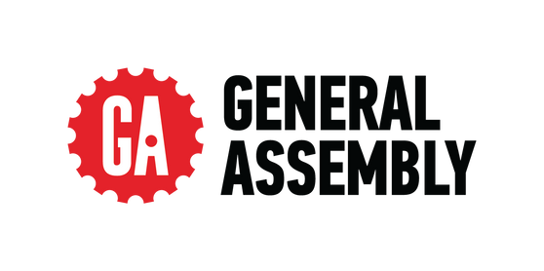
FROM CHURN RISK TO RETENTION STRATEGY
Olist Customer
Segmentation

Slide 2



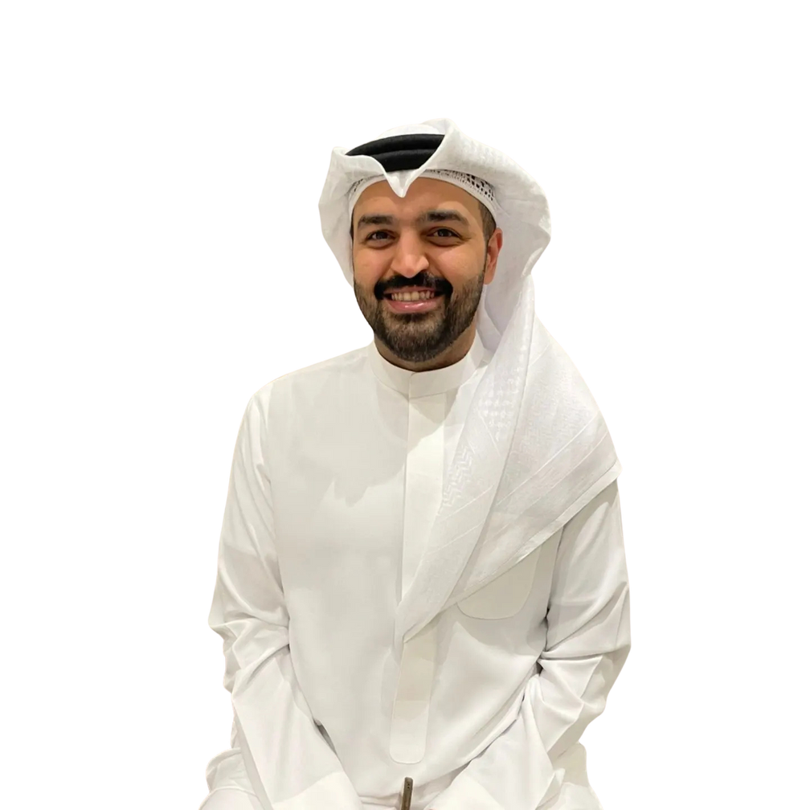
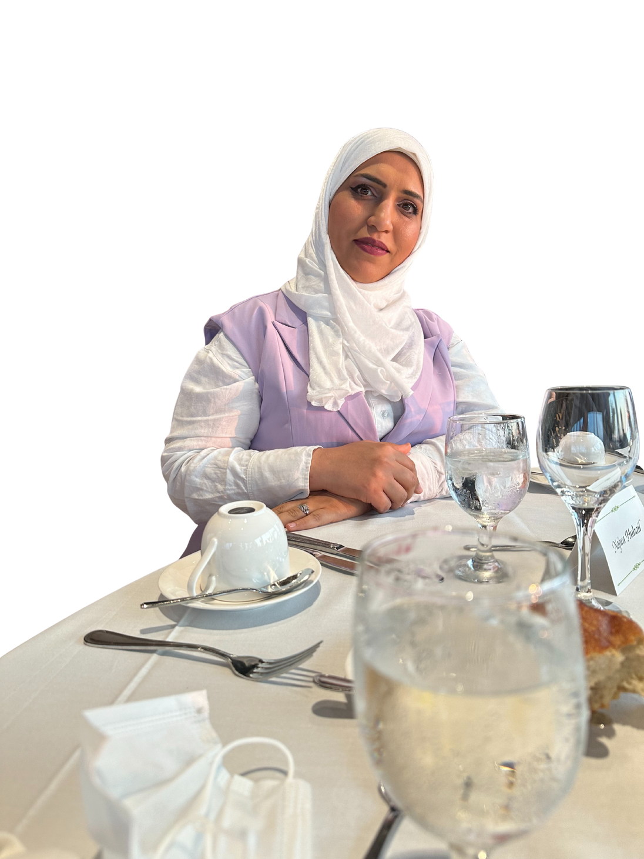
Our Team
Abdulla Osman
Bushra Swar
Hassan Alhashemi
Najwa Ebrahim
CEO
Business Data Analyst
Business Data Analyst
Business Data Analyst
Success isn’t just about selling once, it’s about earning the customer twice.

Slide 3

Objectives
Understanding Olist’s Customers
Main objective is to understand customer behavior and identify the factors that influence retention and churn.
We aim to segment our customers based on recency, frequency and monetary purchasing habits.

Slide 4
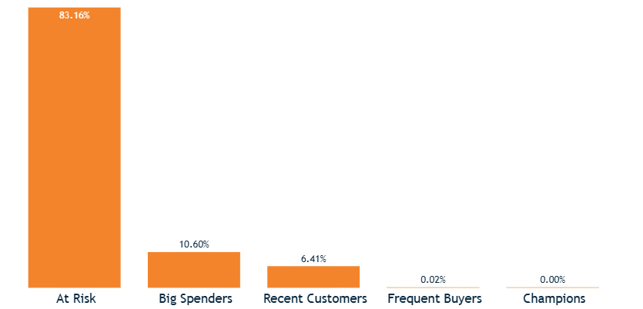
KPI’S and Customers Segmentations
Recency
Increase the share of recent customers to 10%
Frequency
Grow the percentage of frequent buyers to 5%
Monetary
Increase the share of big spenders to 15%

Slide 5




Recommendations
Strengthen partnerships with major banks to provide better installment plans, credit card offers, loyalty rewards, and promotional rates that encourage higher spending and long-term customer retention.
Encourage boleto users to shift toward digital payments by offering faster processing and limited-time incentives to reduce delays and improve transaction efficiency.
Expand the top-performing categories (Bed, Bath & Table, Health & Beauty, and Sports & Leisure) through targeted promotions, marketing campaigns, collaborations with social influencers, and stronger seller partnerships to boost customer satisfaction and increase overall sales growth.
Improve recency by offering short-term discounts with limited expiration periods.
Enhance loyalty programs by rewarding customers with points for every purchase to encourage repeat buying and long-term engagement with Olist.

Slide 6


Data Overview
We used multiple datasets from Olist including orders, payments, reviews, customers, and sellers — all connected through Power BI to explore customer behavior.

Slide 7


THANK YOU

